Slide 1
A short history of affordable massive computing.

Slide 2
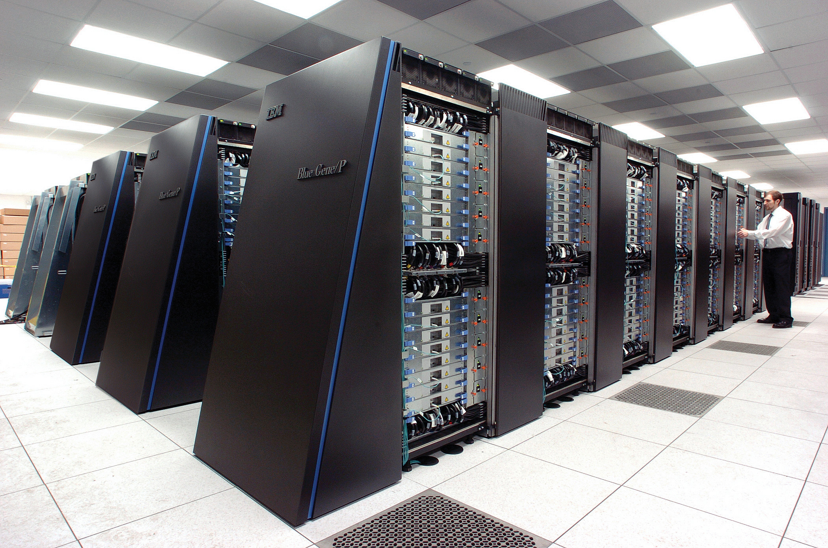
Super computers
Cray, Deep Blue, Blue Gene …
Specialized hardware
Extremely expensive
created to solve specialized important problems

Slide 3
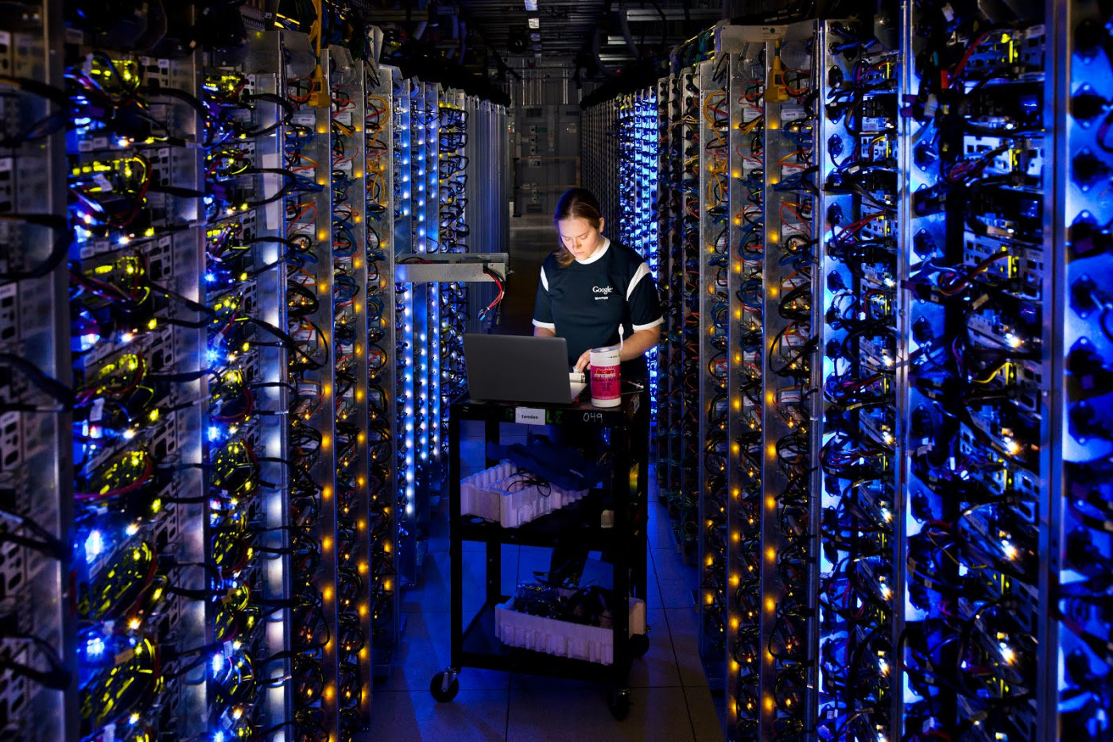
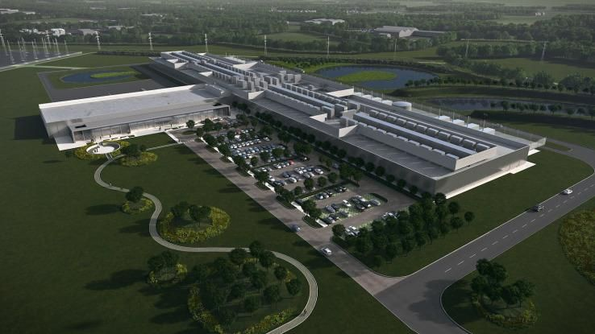
Data Centers

Slide 4
Data Centers
The physical aspect of ”the cloud”
Collection of commodity computers
VAST number of computers (100,000’s)
Created to provide computation for large and small organizations.
Computation as a commodity.

Slide 5
Making History: Google 2003
Larry Page and Sergey Brin develop a method for storing very large files on multiple commodity computers.
Each file is broken into fixed-size chunks.
Each chunk is stored on multiple chunk servers.
The locations of the chunks is managed by the master

Slide 6
HDFS: Chunking files
File 1, Chunk 1
Copy 2
File 1
Split
File 1, Chunk 1
Copy
File 1, Chunk 1
Copy 1
File 1, Chunk 2
Copy 2
File 1, Chunk 2
File 1, Chunk 2
Copy 1
File 1, Chunk 2
Copy 3
File 2, Chunk 1
Copy 2
File 2
Split
File 2, Chunk 1
Copy
File 2, Chunk 1
Copy 1
File 2, Chunk 2
Copy 2
File 2, Chunk 2
File 2, Chunk 2
Copy 1

Slide 7
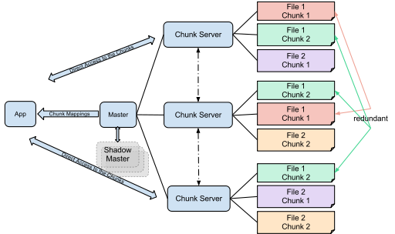
HDFS: Distributing Chunks
File 1, Chunk 1
Copy 1
File 1, Chunk 1
Copy 2
File 1, Chunk 2
Copy 1
File 1, Chunk 2
Copy 2
File 1, Chunk 2
Copy 3
File 2, Chunk 1
Copy 1
File 2, Chunk 1
Copy 2
File 2, Chunk 2
Copy 1
File 2, Chunk 2
Copy 2

Slide 8
Properties of GFS/HDFS
Commodity Hardware: Low cost per byte of storage.
Locality: data stored close to CPU.
Redundancy: can recover from server failures.
Simple abstraction: looks to user like standard file system (files, directories, etc.) Chunk mechanism is hidden.

Slide 9

Redundancy

Slide 10
Locality
Task:
Sum all of the elements in file 1

Slide 11
Map-Reduce
HDFS is a storage abstraction
Map-Reduce is a computation abstraction that works well with HDFS
Allows programmer to specify parallel computation without knowing how the hardware is organized.
We will describe Map-Reduce, using Spark, in a later section.

Slide 12
Spark
Developed by Matei Zaharia , amplab, 2014
Hadoop uses shared file system (disk)
Spark uses shared memory – faster, lower latency.
Will be used in this course
Recall word count by sorting, we will redo it using map-reduce!

Slide 13
The Cloud
The common name for data centers.
What is better? Cloud or your local computers?
Cloud vs. Local: Rent vs. own: if we want a lot of power for a short time, it is cheaper to rent.
Centralized IT: shared staff, shared maintenance, shared upgrade.
Storage:
Long term – cloud storage (multiple TB) much more expensive than local.
Moving TB to/from cloud slow / expensive / physical (snowball)
Like a huge supermarket, there are many choices and it is not easy to find the best combination.

Slide 14
Summary
Big data analysis is performed on large clusters of commodity computers. – computation as a service.
HDFS (Hadoop file system): break down files to chunks, make copies, distribute randomly.
Hadoop Map-Reduce: a computation abstraction that works well with HDFS
Spark: Sharing memory instead of sharing disk.

